Slide 1
Project Presentation of Industry Oriented Hands on Experience (22CS422)
On
Civic Eye
Pratyukt Nag
2210990679
Supervised By
Dr. Shikha Tuteja
Department of Computer Science and Engineering,
Chitkara University, Punjab

Slide 2

Introduction
Modern Digital Solution
Civic Eye transforms grievance redressal with a centralized web platform.
Streamlined Complaint Management
Enables citizens to easily submit, track, and receive updates on complaints.
Role-Based Access for Stakeholders
Distinct dashboards for citizens, department officers, and administrators ensure secure and efficient operations.
Enhanced Transparency & Accountability
Real-time status updates and audit logs promote responsible complaint resolution.
2

Slide 3

Identifying the Problem
Fragmented Grievance Handling
Manual processes lead to delayed responses and inefficient complaint resolution.
Lack of Transparency
Citizens face difficulty tracking complaint status and updates.
Poor Accountability
Limited oversight results in unresolved issues and weak departmental responsibility.
Need for a Centralized Solution
A digital platform can streamline grievance management and enhance efficiency.

Slide 4

System Architecture&Technology
Backend Development
Node.js and Express.js for secure APIs and business logic
Cloud Hosting
Neon/Aiven for scalable, cloud-hosted PostgreSQL
Frontend Development
React.js and Tailwind CSS for modular, responsive UI
Database Layer
PostgreSQL ensures robust, relational data management
CI/CD Deployment
Render/Vercel for continuous integration and deployment

Slide 5




Key Features & Modules
Structured Role-Based Access
Distinct roles for Citizens, Department Oﬃcers, and Super Administrators ensure secure and eﬃcient operations.
Comprehensive Complaint Lifecycle
Users can register complaints, upload documents, and monitor real-time status updates from submission to resolution.
Department & Oﬃcer Management
Super Admins manage departments and assign oﬃcers, streamlining complaint handling and departmental coordination.
Interactive Dashboards & Analytics
Administrative dashboards provide actionable insights, complaint analytics, and system-wide monitoring for improved accountability.

Slide 6
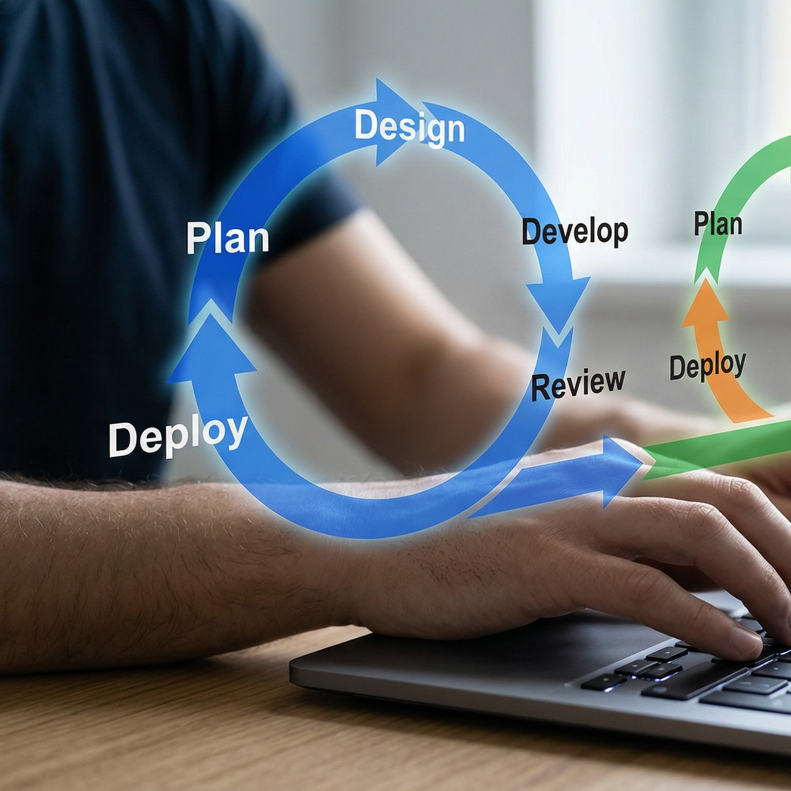
Development Methodology
Phased Development Approach
Adopts an incremental software development model for structured, stepwise progress.
Comprehensive Requirement Analysis
Defines both functional and non-functional requirements, including user roles and system security.
Iterative Design & Testing
Utilizes wireframes, database schemas, and workflow diagrams to guide development.
Continuous unit and integration testing ensure reliability.
Continuous Improvement & Future Enhancements
Planned upgrades include AI-based complaint categorization and automated prioritization.

Slide 7

Takeaways & Impact
Enhanced Transparency & Accountability
Role-based access and real-time updates ensure clear audit trails.
Eﬃcient Complaint Resolution
Digitizes grievance handling for faster response and improved tracking.
Empowering Stakeholders
Citizens and administrators benefit from intuitive dashboards and secure workflows.
Future-Ready Platform
Scalable architecture supports AI-driven enhancements and ongoing improvements.

Slide 8
Thank You
8

